Slide 1

Visual Basic.NET Introduction

Slide 2
ROAD MAP
Introduction
Building a class
A “Real” Class
Inheritance
Polymorphism
Object Constructors and Destructors

Slide 3
INTRODUCTION
Classes are at the very heart of Visual Studio
Classes are used routinely in team development
The major driving force behind object-oriented programming
code reuse

Slide 4
Class
a program that doesn’t run on its own
Must be used by another application
similar to Windows controls
only they don’t have a visible interface

Slide 5
Building the Minimal Class
May reside in the same file as a Form
Customary to implement custom classes in a separate module
a Class module
a class doesn’t run on its own
can’t test it without a form
Create a Windows application
Add the class to it
Test it by adding the appropriate code to the form

Slide 6
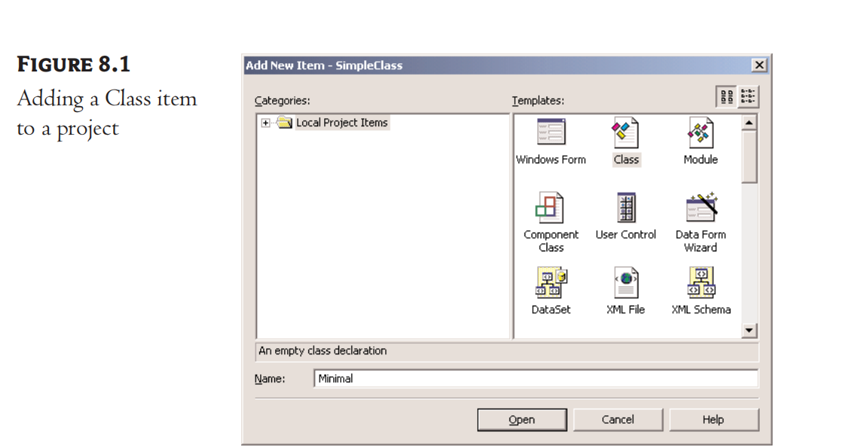
Building a Minimal Class
Start a new class - -simple class

Slide 7
Adding Code to the Minimal Class
property1 (a String)
property2 (a Double)
ReverseString method
reverses the order of the characters in property1
Return New String
NegateNumber method
returns the negative of property2
Don’t accept arguments

Slide 8
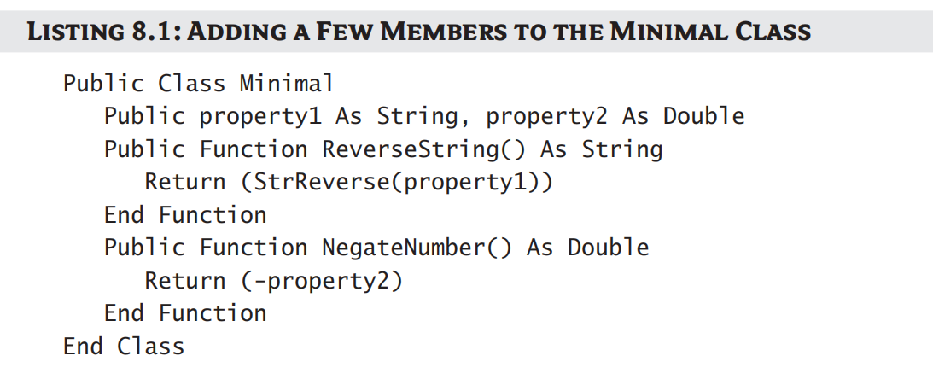
Adding Code to the Minimal Class

Slide 9
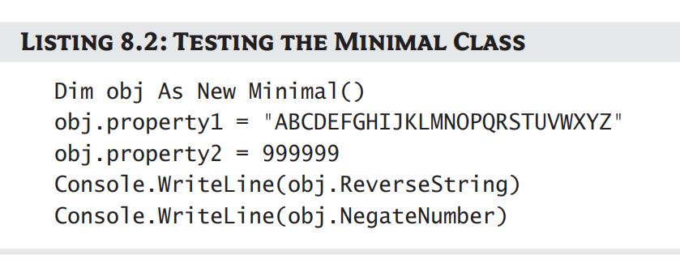
Adding Code to the Minimal Class
Test

Slide 10
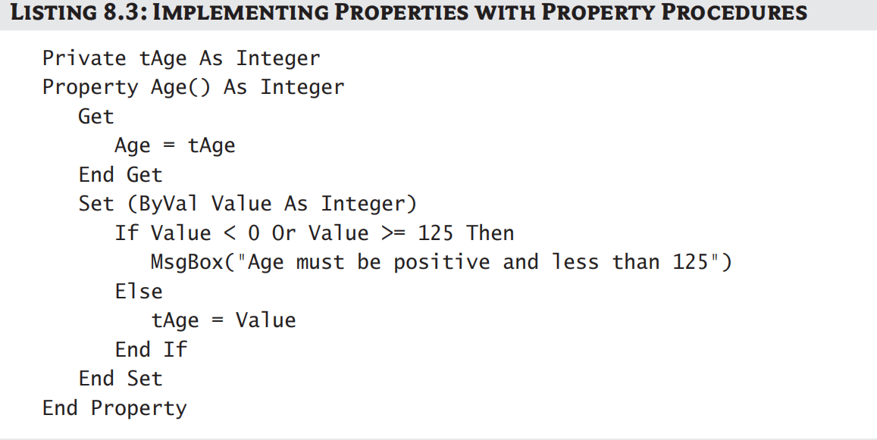
Property Procedures
accept any value
as long as the type is correct and the value of the numeric property is within the acceptable range
Generic properties were meaningful entities
Using Property Procedures

Slide 11
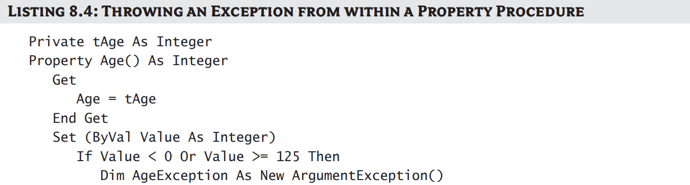
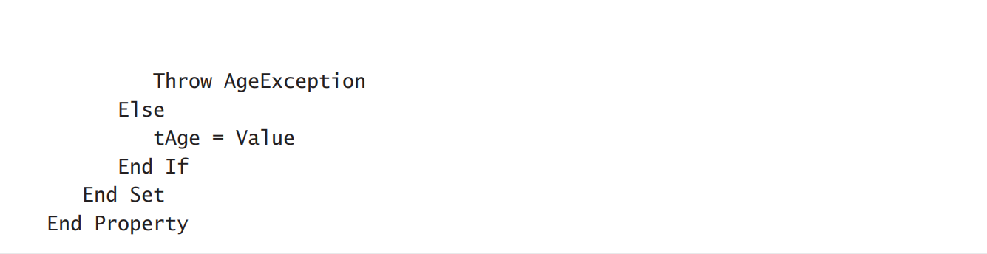
Raising Exceptions
To receive an exception and handle it from within your code

Slide 12
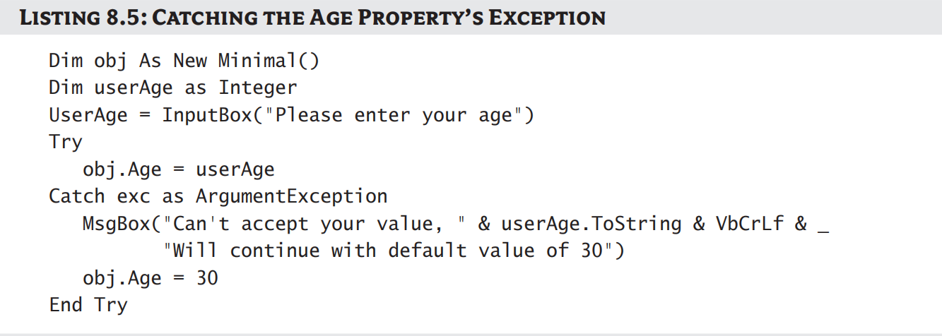
Catching Exception

Slide 13
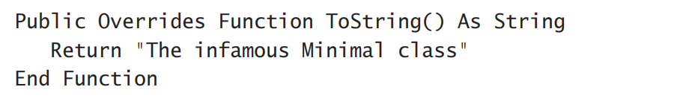
Customizing Default Members
Default members when building a class
ToString method
Provide your custom implementation for these members
Example:

Slide 14
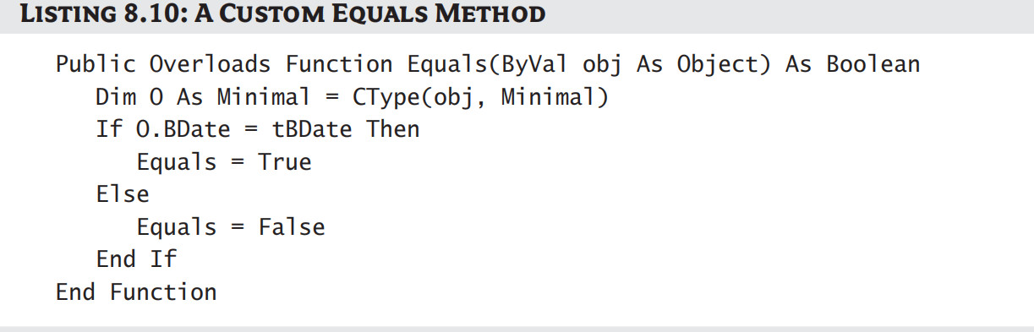
Customizing Default Members
Implementing of a custom equal method

Slide 15
A “Real” Class
A more practical class
ExtractPathName and ExtractFileName methods
extract the file and path name from a full filename
Num2String Method
converts a numeric value (an amount) to the equivalent string

Slide 16
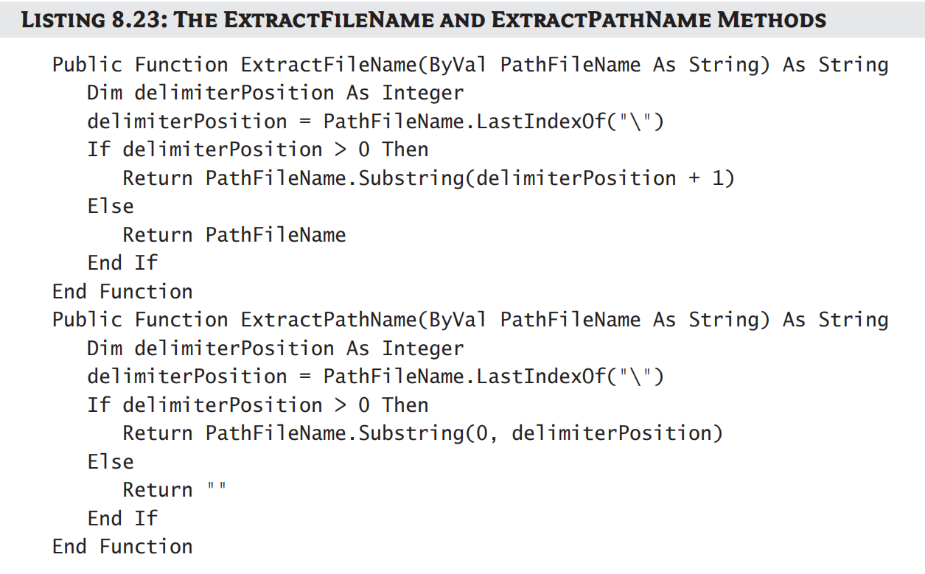
Parsing a Filename String
Implemeting ExtractFileName and ExtractPathName Methods

Slide 17
Reusing the StringTools Class
Create the class’s executable file
Exclude the test form from the project
Right-click the name of the test form
Select Exclude From Project
Now, only contains the StringTools class

Slide 18
Inheritance
The ability to create a new class based on an existing one
Parent class, or base class – the existing class
Subclass, or, derived class -- the new class (that inherit the base class)
Overriding
The replacement of existing members with other ones

Slide 19
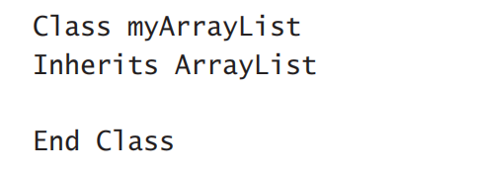
Inherit Existing Class
Call the new class myArrayList
If you don’t add a single line of code, the functionality remains same

Slide 20
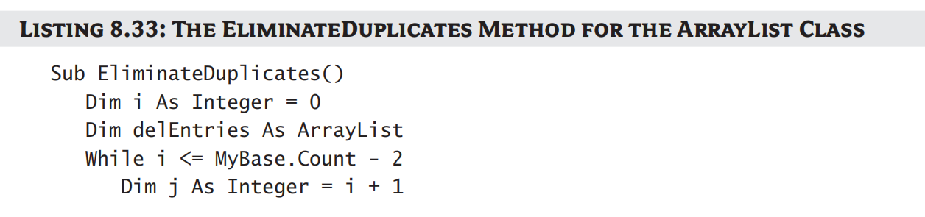
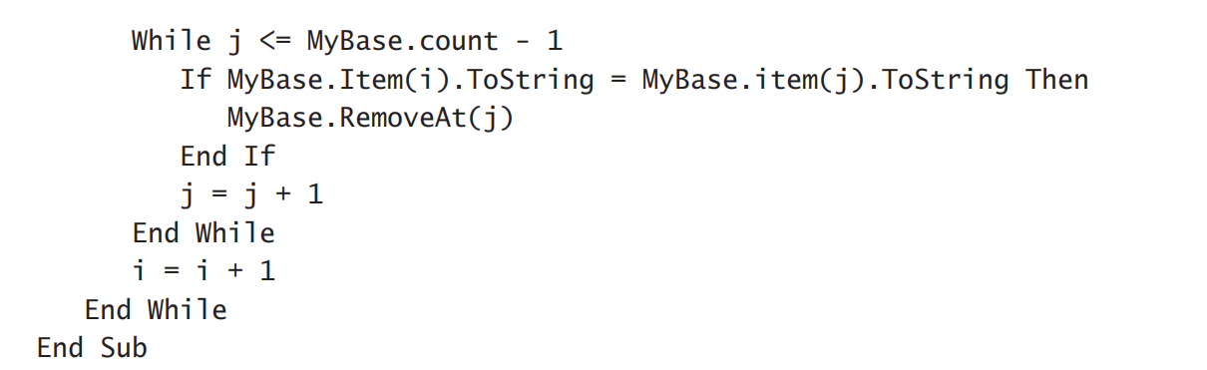
Inheriting Existing Class
Add a EliminateDuplicates() subroutine to arraylist

Slide 21


Polymorphism
The ability of a base type to adjust itself to accommodate many different derived types
Eg. English word : “run”
Shape class (parent)
Triangular, Circular…..
Area Method is applied in these classes
If shape2 represents a circle

Slide 22
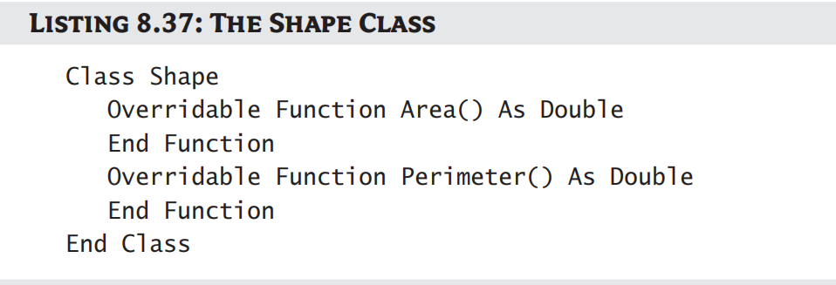
Polymorphism
Shape class

Slide 23
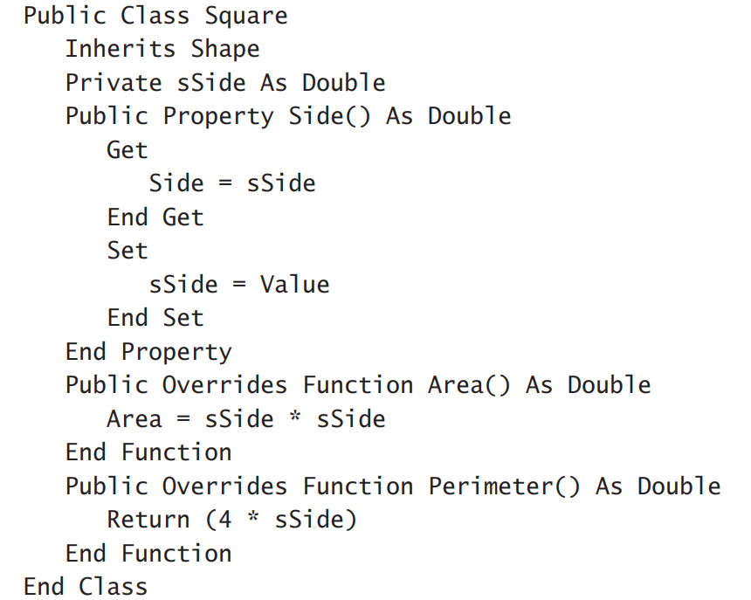
Polymorphism
Square class

Slide 24
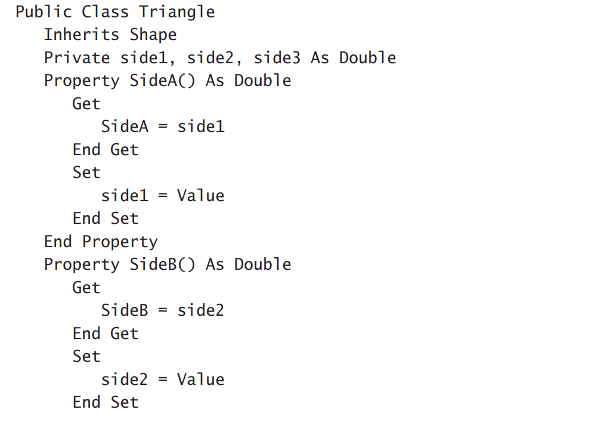
Polymorphism
Triangular Class

Slide 25
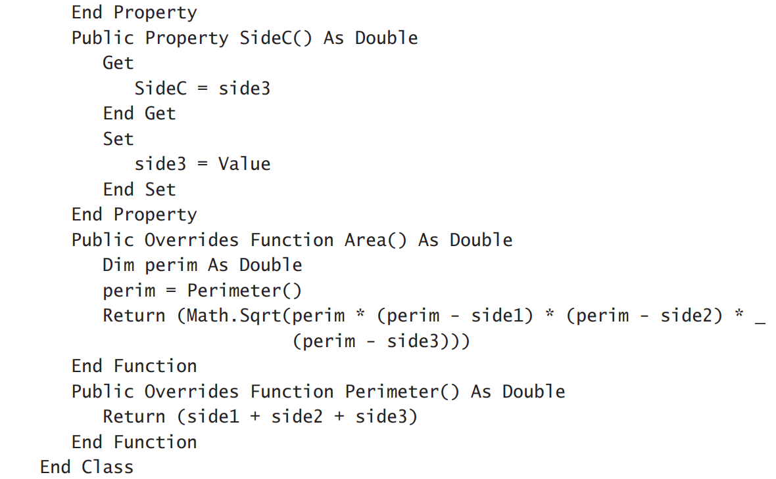
Polymorphism
Triangular Class

Slide 26
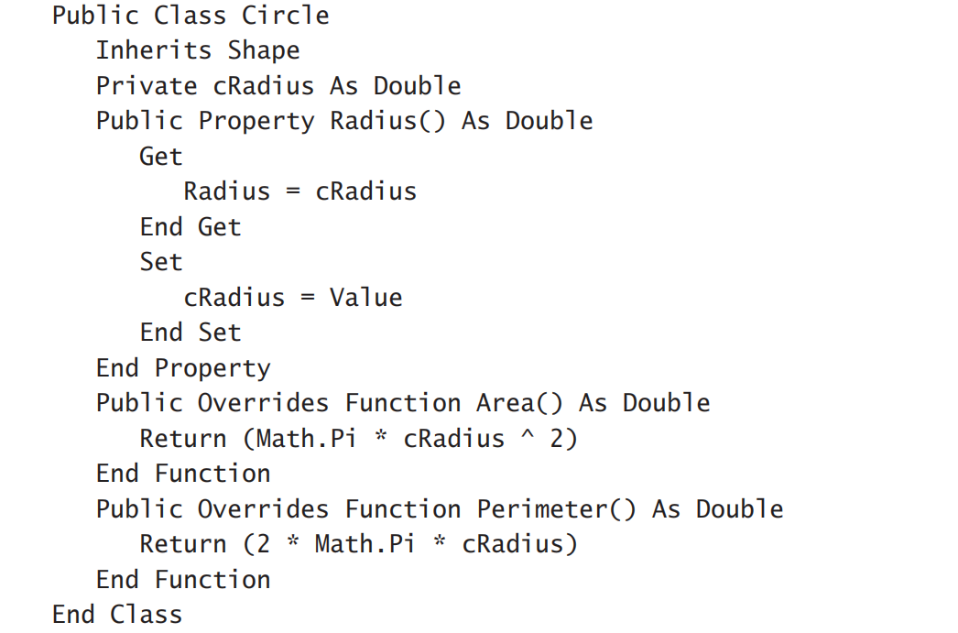
Polymorphism
Circle Class

Slide 27

Object Constructors and Destructors
Recall:
objects are created and then disposed of when no longer needed
To construct an object
Declare it and then set it to a new instance of the class it represents
Example: to construct a triangle
Specify the properties of an object in the same line that creates the object
This is called constructor

Slide 28
Object Constructor and Destructor
Constructor
initialize the object by setting some or all of its properties
parameterized constructor
allow you to pass arguments to an object as you declare it
Constructors are implemented with the New subroutine
called every time a new instance of the class is initialized

Slide 29
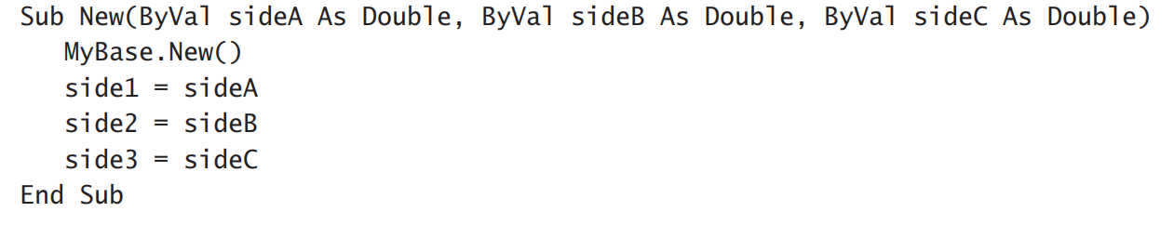
Object Constructor and Destructor
Initialize Triangle Class

Slide 30
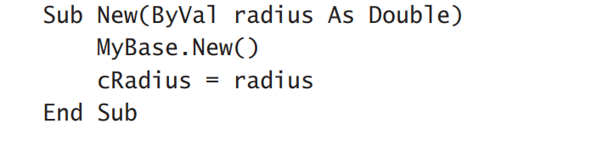
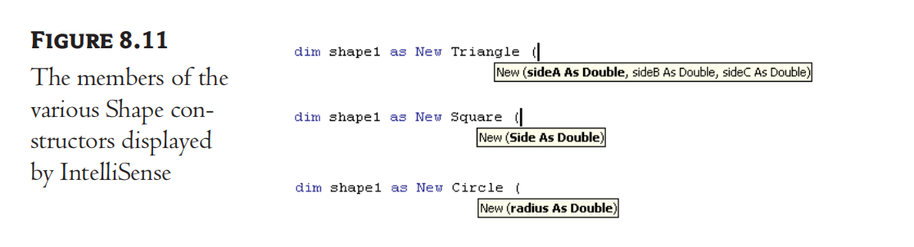
Object Constructor and Destructor
parameterized constructor of the Circle class:
When we enter “Dim shape1 As New Triangle(“

Slide 31
Exercise
(1) If Full filename is“c:\Documents\Recipes\Chinese\Won Ton.txt”, what will be returned by ExtractFileName method and ExtractPathName method?
(2) What will be returned by Num2String Method?
$12,544

Slide 32
Answer
(1) “Won Ton.txt”
“c:\Documents\Recipes\Chinese\”
(2) “Twelve Thousand, Five Hundred And Forty Four.”

